Slide 1
Logistikbus
Logistikbus is a bundle of 15 applications that allow retailers to manage and control their inventory, place BEFORE orders, process exchange parts and make complaints about orders. Logistikbus contains all movement and inventory data about the supply chain. It also provides numerous inventory management and controlling functions for wholesale.

Slide 2




System: Logistikbus
Logistics network
SYSTEM LANDSCAPE
Criticality
SPICS
DuB
Customer Business Impact: High Failure of the Logistics Bus application prevents BEFORE orders from retail in wholesale and > 3,300 retailers may not be able to order stock replenishment
GLC
SPM
ISBI
Diverse DMS
PROMO
……
PARAGON
Wholesale
ELS
NACOS
Logbus
WebParts
Communication partner systems
Of central importance are the online MQ connections to SPM, SPICS, PARAGON, BPM-Star. If other interfaces are disrupted, central batch processes may be affected.
……
PRIMUS
Retailer
…
…
…
BPM Star
IPS
Location
Technology
Contact person
DE | CW Germersheim
DE | All LC‘s
EU BR | All ELC‘s Campinas (DIMS)
CHN | CHINA (WIMS)
KO | KOREA (WIMS)
TW | TAIWAN (WIMS)
World | 3.100 DIMS-Retailer worldwide
PAI-Framework, J2EE, Java
Oracle database
IBM-Websphere application server
Communication with partner systems via MQ Series, RFTSX, JCO, WebService
Rolle | Name | E-Mail | Telefon
Daimler Business Owner | Bernhard Hahme | Bernhard.Hahme@daimler.com | ???
Daimler Business Owner Contact | Thorsten Nau | Thorsten.Nau@daimler.com | +49 1 51-58 60 26 48
Daimler Technical Owner | Gerd Deckers | Gerd.Deckers@daimler.com | +49 176 30959510
Daimler Technical Owner Contact | Berthold Brecht | Berthold Brecht@daimler.com | +49-(0)7274-56-3399
Daimler Helpdesk | UHD |  | +49 7274 56 5555
TSI: Cluster Manager | Christoph Jäger | christoph.jaeger@t-systems.com | +49 175 4157178
TSI: Projektleiter | Sven Laubenstein | Sven.Laubenstein@t-systems.com | +49 170 791 7427
TSI Service Desk |  | Cluster_Logistics_AM@T-Systems.com | 0391/59760-4942626
TSI Service Manager | Petra Bail-End | Petra.Bail-End | +49 1717932023
Oberator | EDC | Edc_Hotline@daimler.com | +49 711 – 17 75333
User
Service level agreement (=Service Desk)
> 25.000 User
Mon–Fri 0:00 - 24:00 Servicetime Response time Prio-1: 1,0 h, Prio-2: 4 h, Prio-3: 16 h
Sat: 0:00 – 12:00 Servicetime Prio-4: upon consultation On-call duty: Public holiday + Release activities
Business day/Public holiday according to the calendar /Germany, federal state Baden-Württemberg, Language: German + January 6th
Notes:
13.08.2007
2
Autor / Thema der Präsentation

Slide 3
Logistikbus-Applications.
critical
DIMS
SICOS
STOX
Simulation
DgS
Vendor Managed Inventory
Stock Controlling Retail
Overstock- exchange
DIMS Simulation- system
DIMS goes Sales
Retail
critical
critical
StarOrder
StarOrderplus
SCOT
ClaiMS
CORS
SCM
PRE Orders, Claim
PRE, order transparancy, Claim
Order transparency
Exchange Parts Management
Claim
SCSM
SCART
Netzdispo
SCM
Bottleneck Management
Controlling regional stock
Inventory Management
LBPS
NEWS
INFRA
Authorization management
News
Notes:
13.08.2007
3
Autor / Thema der Präsentation

Slide 4
BACKUP
Notes:
13.08.2007
4
Autor / Thema der Präsentation

Slide 5


DIMS - Embedding in system environment.
DMS-System of the dealer
Dealer: Edits order proposals
Experts: control by parameter
Regional stock / Supplier
Internet- based GUI
GUI + Simulator
Deletes, changes,
creates orders
Control Service level,
LUH (Stock turnover rate) Number of orders
Zentrales Händler-Dispositions-System
Sell offs,
Incoming goods,
Stocks,... (daily)
Import
Forecast, Calculate
safety stock
Order
invoice
Order
for-
warding
Order
Order-
Processing- System
Confi-data/Delivery per dealer
Notes:
13.08.2007
5
Autor / Thema der Präsentation

Slide 6
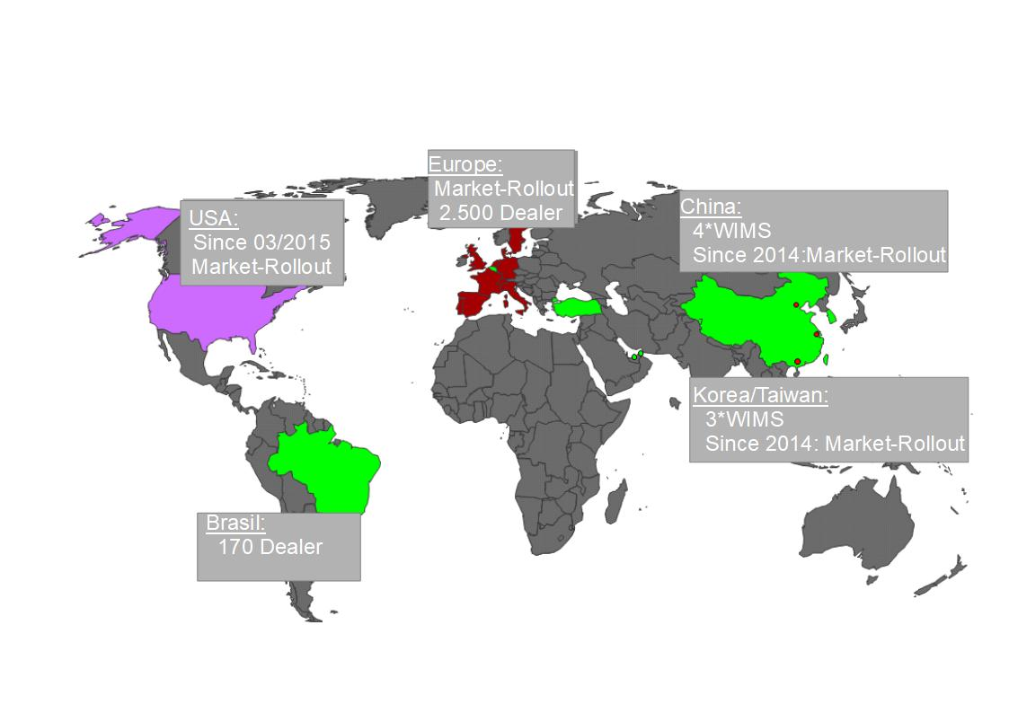
DIMS-Rollout Worldwide.
Notes:
13.08.2007
6
Autor / Thema der Präsentation

Slide 7



StarOrder / StarOrderplus – Create PREORDER.
Logistikbus
SPICS- BackendS
StarOrder GUI
SPM- Backend
StarOrder plus GUI
Notes:
13.08.2007
7
Autor / Thema der Präsentation

Slide 8
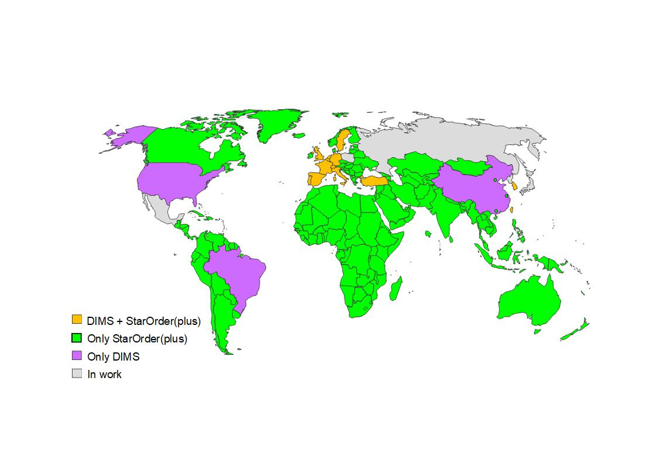
SO/Soplus AND DIMS-Rollout wORLDWIDE.
Notes:
13.08.2007
8
Autor / Thema der Präsentation

